Slide 1
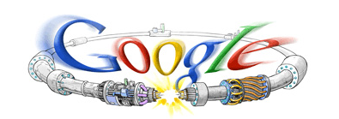
Upgrade Path for the LHC and the Role of US Collaboration
Eric Prebys, Fermilab
Director, US LHC Accelerator Research Program (LARP)
Google welcome screen from September 10, 2008

Slide 2

A Word about LARP
The US LHC Accelerator Research Program (LARP) coordinates US R&D related to the LHC accelerator and injector chain at Fermilab, Brookhaven, SLAC, and Berkeley (with a little at J-Lab and UT Austin)
LARP has contributed to the initial operation of the LHC, but much of the program is focused on future upgrades.
The program is currently funded at a level of about $12-13M/year, divided among:
Accelerator research
Magnet research
Programmatic activities, including support for personnel at CERN
NOT to be confused with this “LARP” (Live-Action Role Play), which has led to some interesting emails
(more about LARP later)

Slide 3
Outline
Overview of the LHC
2008 Startup
“The Incident” and Response
Current Commissioning Status and Plans
Upgrade Issues
Plan through 2020
LARP/US Role

Slide 4
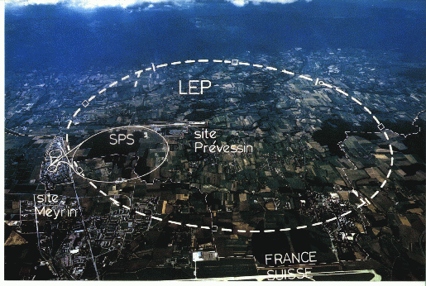
LHC: Location, Location, Location…
/LHC
Tunnel originally dug for LEP
Built in 1980’s as an electron positron collider
Max 100 GeV/beam, but 27 km in circumference!

Slide 5
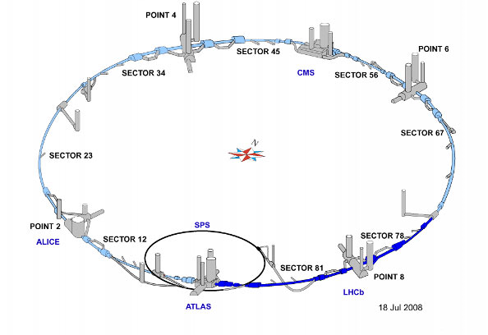
LHC Layout
8 crossing interaction points (IP’s)
Accelerator sectors labeled by which points they go between
ie, sector 3-4 goes from point 3 to point 4

Slide 6
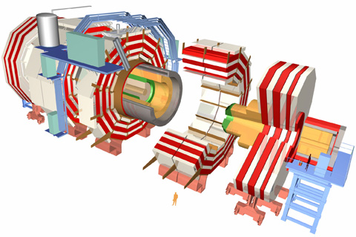
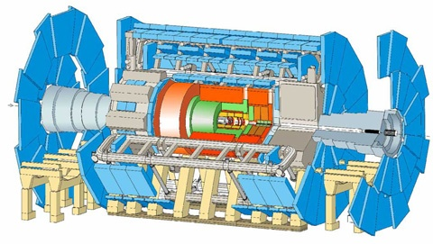
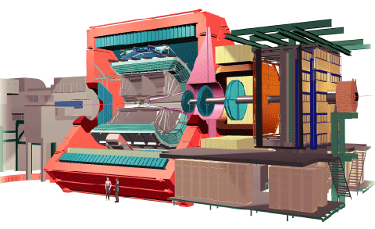
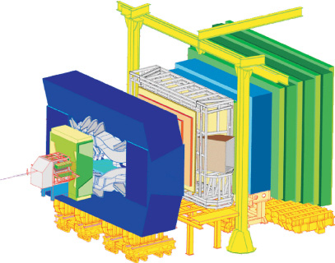
CERN Experiments
Huge, general purpose experiments:
“Medium” special purpose experiments:
Compact Muon Solenoid (CMS)
A Toroidal LHC ApparatuS (ATLAS)
A Large Ion Collider Experiment (ALICE)
B physics at the LHC (LHCb)

Slide 7
Nominal LHC Parameters Compared to Tevatron
Parameter | Tevatron | “nominal” LHC
Circumference | 6.28 km (2*PI) | 27 km
Beam Energy | 980 GeV | 7 TeV
Number of bunches | 36 | 2808
Protons/bunch | 275x10⁹ | 115x10⁹
pBar/bunch | 80x10⁹ | -
Stored beam energy | 1.6 + .5 MJ | 366+366 MJ*
Peak luminosity | 3.3x10³² cm⁻²s⁻¹ | 1.0x10³⁴ cm⁻²s⁻¹
Main Dipoles | 780 | 1232
Bend Field | 4.2 T | 8.3 T
Main Quadrupoles | ~200 | ~600
Operating temperature | 4.2 K (liquid He) | 1.9K (superfluid He)
1.0x10³⁴ cm⁻²s⁻¹ ~ 50 fb⁻¹/yr
*2.1 MJ ≡ “stick of dynamite” ⇒ very scary numbers

Slide 8
Partial LHC Timeline
1994:
The CERN Council formally approves the LHC
1995:
LHC Technical Design Report
2000:
LEP completes its final run
First dipole delivered
2005
Civil engineering complete (CMS cavern)
First dipole lowered into tunnel
2007
Last magnet delivered
First sector cold
All interconnections completed
2008
Accelerator complete
Last public access
Ring cold and under vacuum

Slide 9
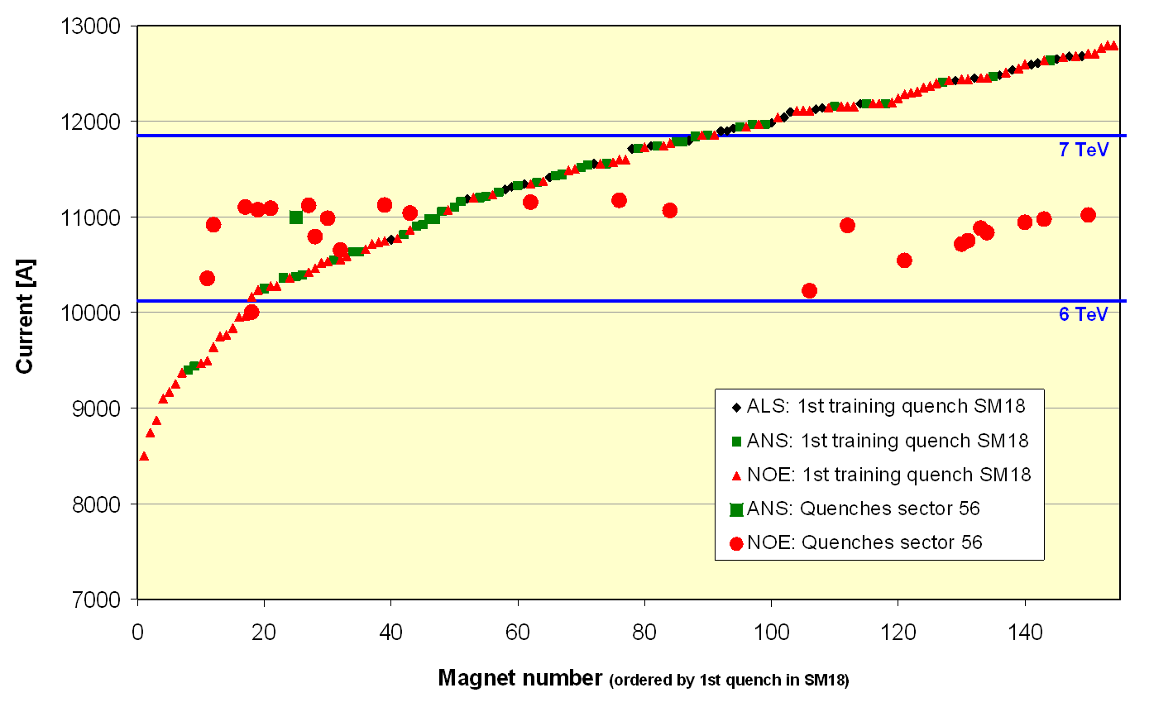
Problems out of the Gate
Magnet de-training
ALL magnets were “trained” to achieve 7+ TeV.
After being installed in the tunnel, it was discovered that the magnets supplied by one of the three vendors “forgot” their training.
Symmetric Quenches
The original LHC quench protection system was insensitive to quenches that affected both apertures simultaneously.
While this seldom happens in a primary quench, it turns out to be common when a quench propagates from one magnet to the next.
1st Training quench above ground
1st quench in tunnel
For these reasons, the initial energy target was reduced to 5+5 TeV well before the start of the 2008 run.

Slide 10
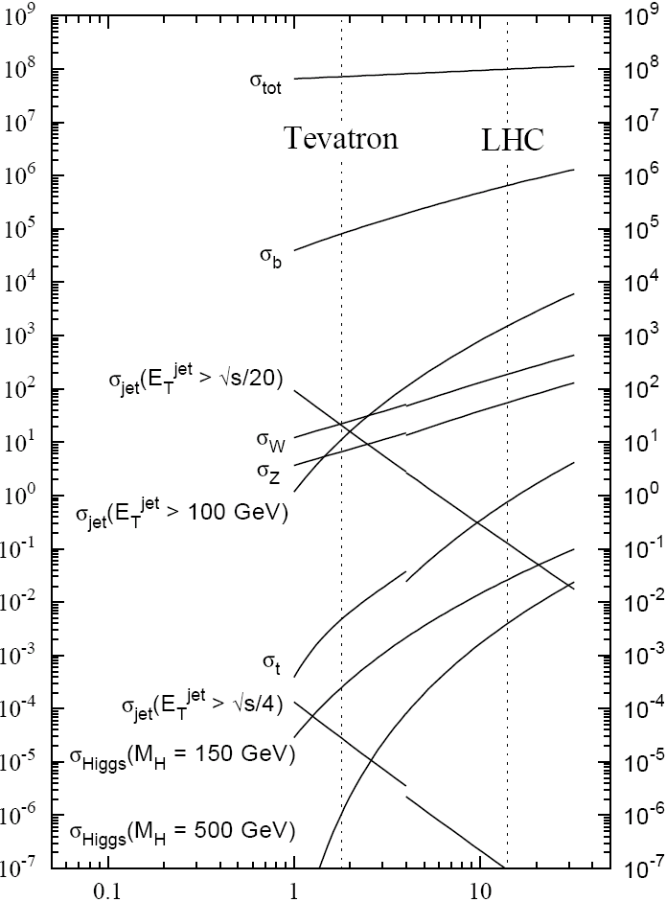
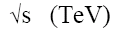
Experimental reach of LHC vs. Tevatron
200 pb⁻¹ at 5 TeV+5 TeV
~5 fb⁻¹ at 1 TeV+ 1 TeV
σ_{W} (M_{W}=80 GeV)
σ_{Z} (M_{Z}=91 GeV)

Slide 11
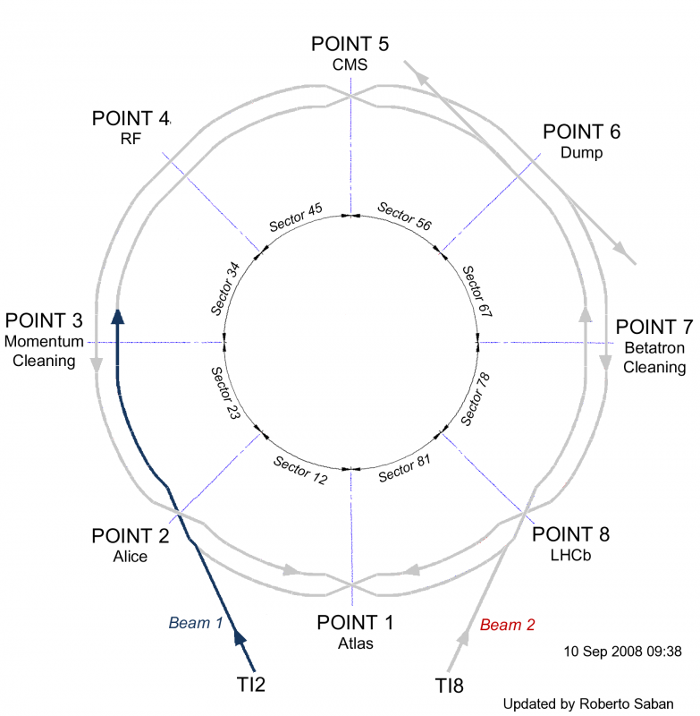
September 10, 2008: The Big Day
September 10, 2008: The (first) Big Day
Plotted the biggest media event in the history of science
This plot shows how far beam had been prior to Sept. 10.
Progress prior to event

Slide 12
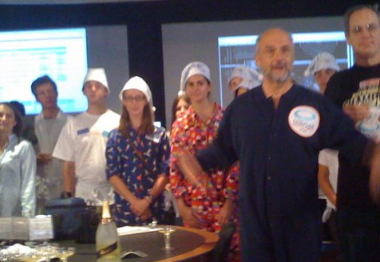
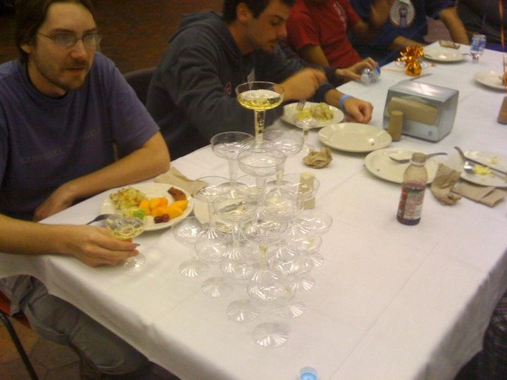
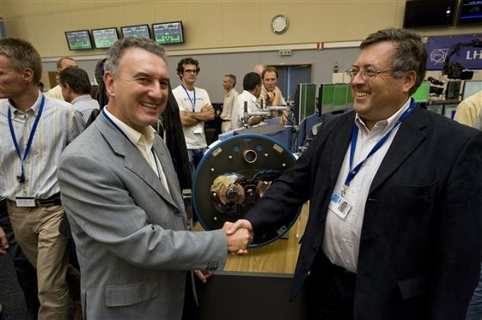
It begins…
9:35 – First beam injected
9:58 – beam past CMS to point 6 dump
10:15 – beam to point 1 (ATLAS)
10:26 – First turn!
…and there was much rejoicing
Commissioning proceeded smoothly and rapidly until September 19th, when something very bad happened

Slide 13

Nature abhors a (news) vacuum…
Italian newspapers were very poetic (at least as translated by “Babel Fish”):
"the black cloud of the bitterness still has not been dissolved on the small forest in which they are dipped the candid buildings of the CERN"
“Lyn Evans, head of the plan, support that it was better to wait for before igniting the machine and making the verifications of the parts.“*
Or you could Google “What really happened at CERN”:
**
* “Big Bang, il test bloccato fino all primavera 2009”, Corriere dela Sera, Sept. 24, 2008
**http://www.rense.com/general83/IncidentatCERN.pdf

Slide 14
What (really) really happened on September 19^{th*}
Sector 3-4 was being ramped to 9.3 kA, the equivalent of 5.5 TeV
All other sectors had already been ramped to this level
Sector 3-4 had previously only been ramped to 7 kA (4.1 TeV)
At 11:18AM, a quench developed in the splice between dipole C24 and quadrupole Q24
Not initially detected by quench protection circuit
Power supply tripped at .46 sec
Discharge switches activated at .86 sec
Within the first second, an arc formed at the site of the quench
The heat of the arc caused Helium to boil.
The pressure rose beyond .13 MPa and ruptured into the insulation vacuum.
Vacuum also degraded in the beam pipe
The pressure at the vacuum barrier reached ~10 bar (design value 1.5 bar). The force was transferred to the magnet stands, which broke.
*Official talk by Philippe LeBrun, Chamonix, Jan. 2009

Slide 15
Pressure forces on SSS vacuum barrier
Vacuum
Pressure
1 bar
1/3 load on cold mass (and support post)
~23 kN
1/3 load on barrier
~46 kN
Total load on 1 jack ~70 kN
V. Parma

Slide 16
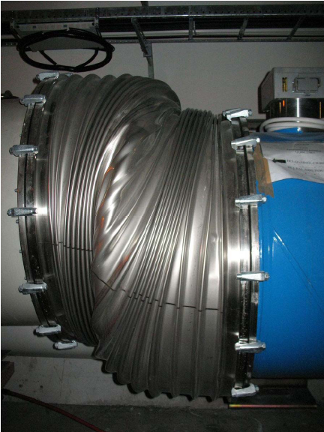
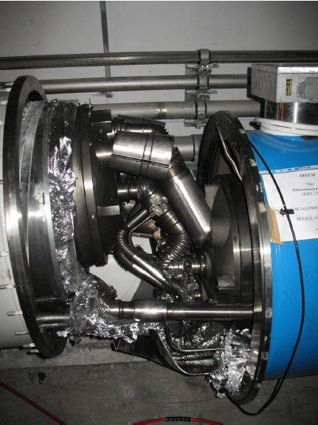
Collateral Damage: Magnet Displacements
QQBI.27R3

Slide 17
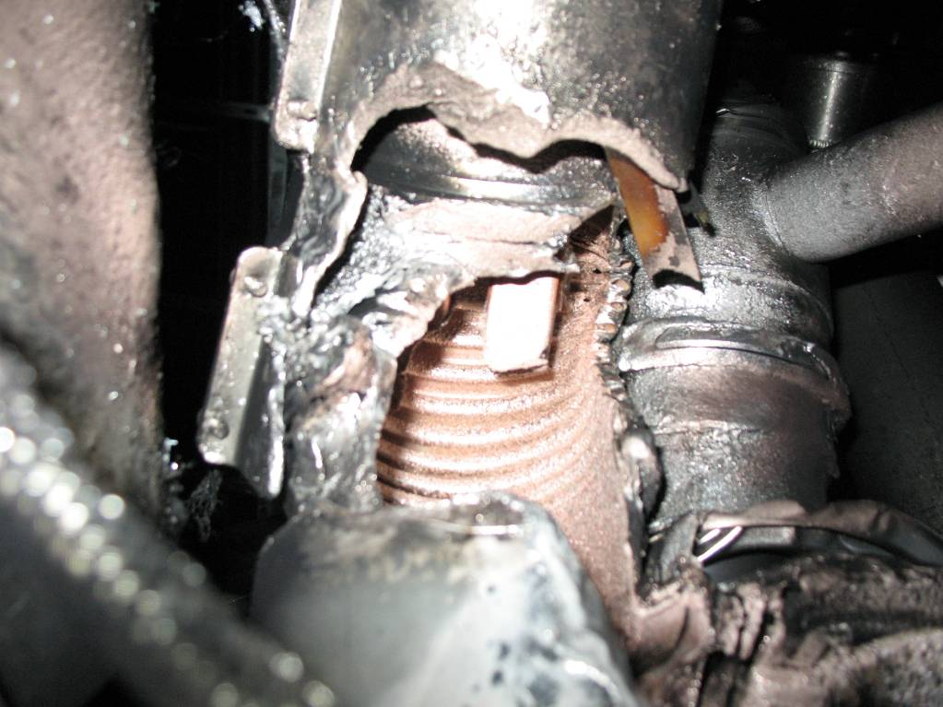
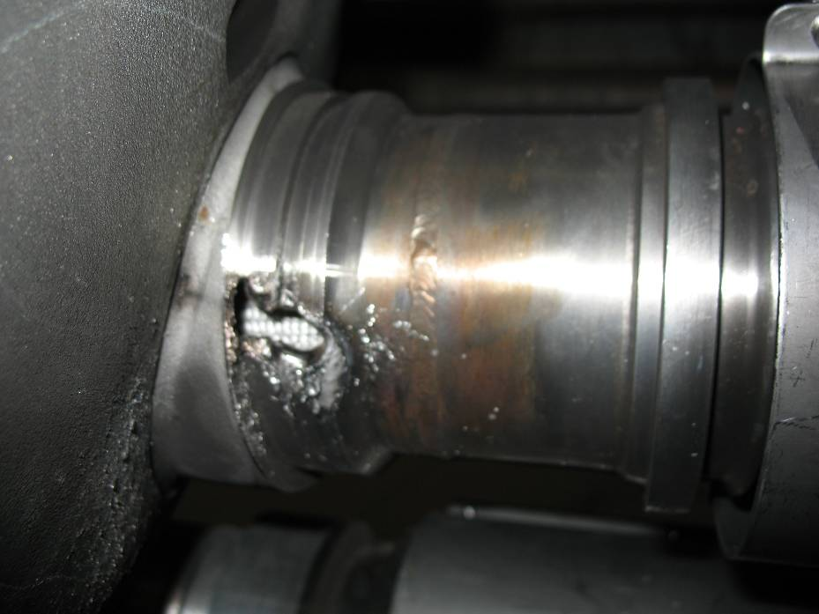
Collateral Damage: Secondary Arcs
QBBI.B31R3 M3 line
QQBI.27R3 M3 line

Slide 18
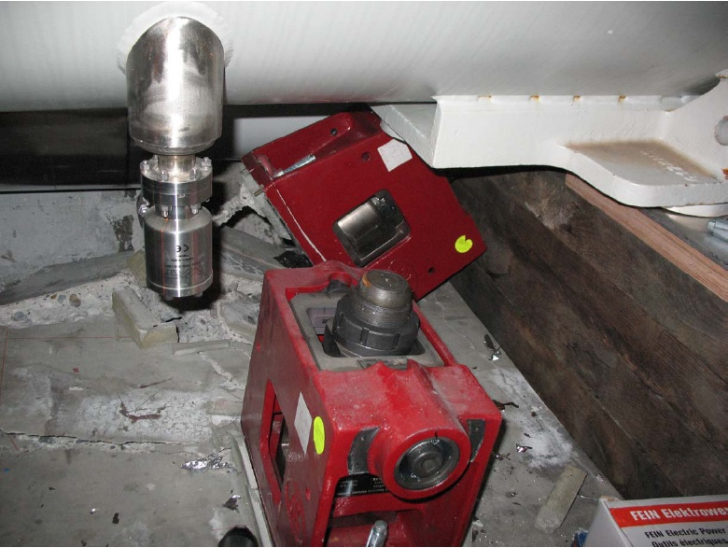
Collateral Damage: Ground Supports

Slide 19
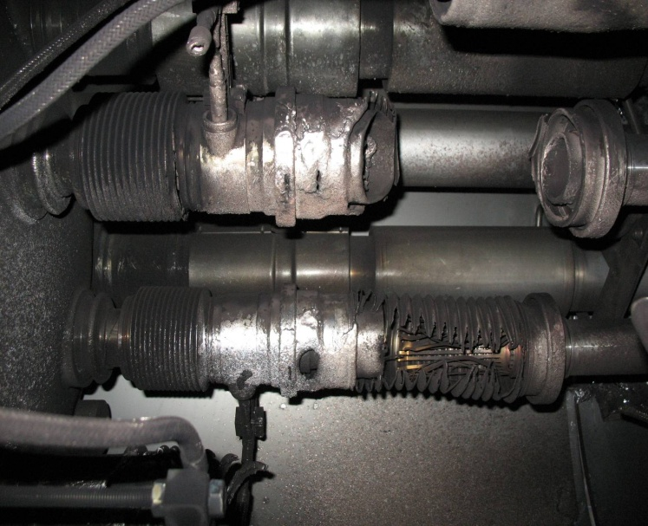
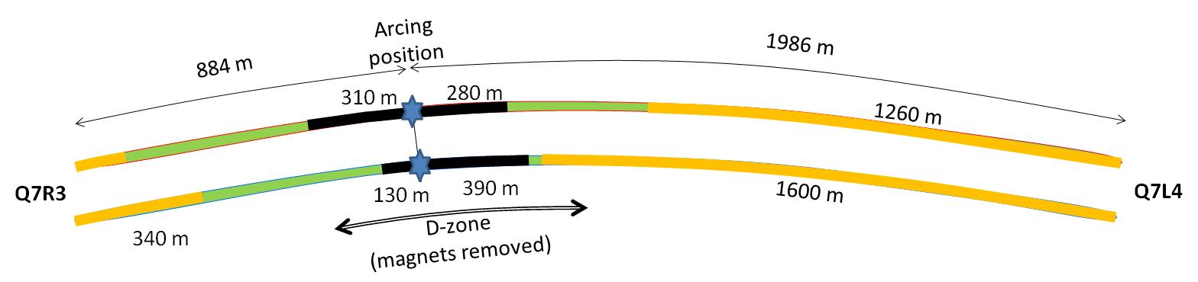

Collateral Damage: Beam Vacuum
Arc burned through beam vacuum pipe
clean
MLI
soot
The beam pipes were polluted with thousands of pieces of MLI and soot, from one extremity to the other of the sector
LSS3
LSS4
OK
Debris
MLI
Soot

Slide 20
Important Questions About “The Incident”
Why did the joint fail?
Inherent problems with joint design
No clamps
Details of joint design
Solder used
Quality control problems
Why wasn’t it detected in time?
There was indirect (calorimetric) evidence of an ohmic heat loss, but these data were not routinely monitored
The bus quench protection circuit had a threshold of 1V, a factor of >1000 too high to detect the quench in time.
Why did it do so much damage?
The pressure relief system was designed around an MCI Helium release of 2 kg/s, a factor of ten below what occurred.

Slide 21
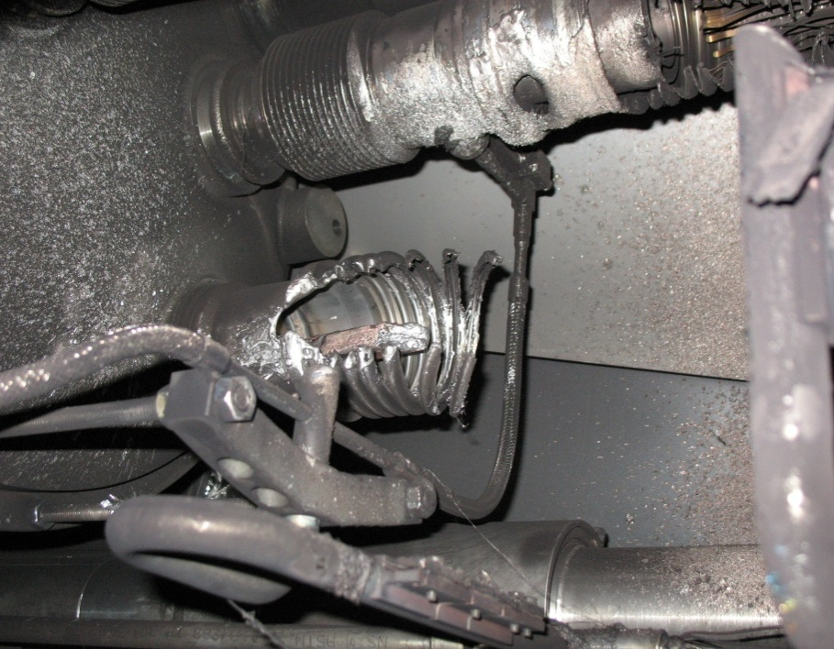
What happened?
Working theory: A resistive joint of about 220 nΩ with bad electrical and thermal contacts with the stabilizer
No electrical contact between wedge and U-profile with the bus on at least 1 side of the joint
No bonding at joint with the U-profile and the wedge
Loss of clamping pressure on the joint, and between joint and stabilizer
Degradation of transverse contact between superconducting cable and stabilizer
Interruption of longitudinal electrical continuity in stabilizer
Problem: this is where the evidence used to be
A. Verweij

Slide 22
Improvements
Bad joints
Test for high resistance and look for signatures of heat loss in joints
Warm up to repair any with signs of problems (additional three sectors)
Quench protection
Old system sensitive to 1V
New system sensitive to .3 mV (factor >3000)
Pressure relief
Warm sectors (4 out of 8)
Install 200mm relief flanges
Enough capacity to handle even the maximum credible incident (MCI)
Cold sectors
Reconfigure service flanges as relief flanges
Reinforce floor mounts
Enough capacity to handle the incident that occurred, but not quite the MCI

Slide 23
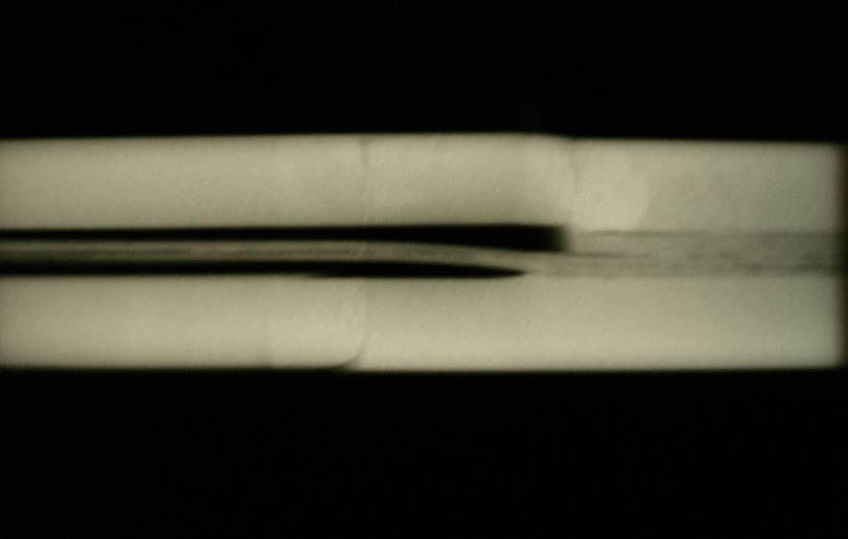
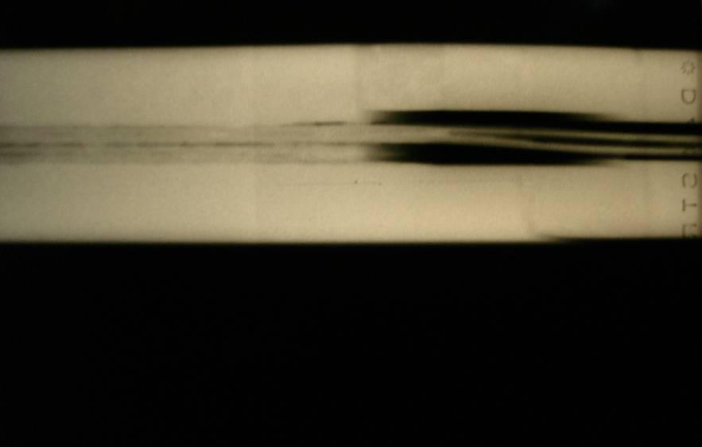
Bad surprise
With new quench protection, it was determined that joints would only fail if they had bad thermal and bad electrical contact, and how likely is that?
Very, unfortunately ⇒ must verify copper joint
Have to warm up to at least 80K to measure Copper integrity.
Solder used to solder joint had the same melting temperature as solder used to pot cable in stablizer
⇒Solder wicked away from cable

Slide 24
Impact of Joint Problem
Tests at 80K identified an additional bad joint
One additional sector was warmed up
New release flanges were NOT installed
Based on thermal modeling of the joints, it was determined that they might NOT be reliable even at 5 TeV
3.5 TeV considered the maximum safe operating energy for now
Decision:
Run at 3.5+3.5 TeV until the end of 2011 or 1 fb⁻¹, whichever comes first.
Shut down for ~15 months to repair all 10,000 (!!) joints.
Dismantle
Re-solder
Clamp

Slide 25
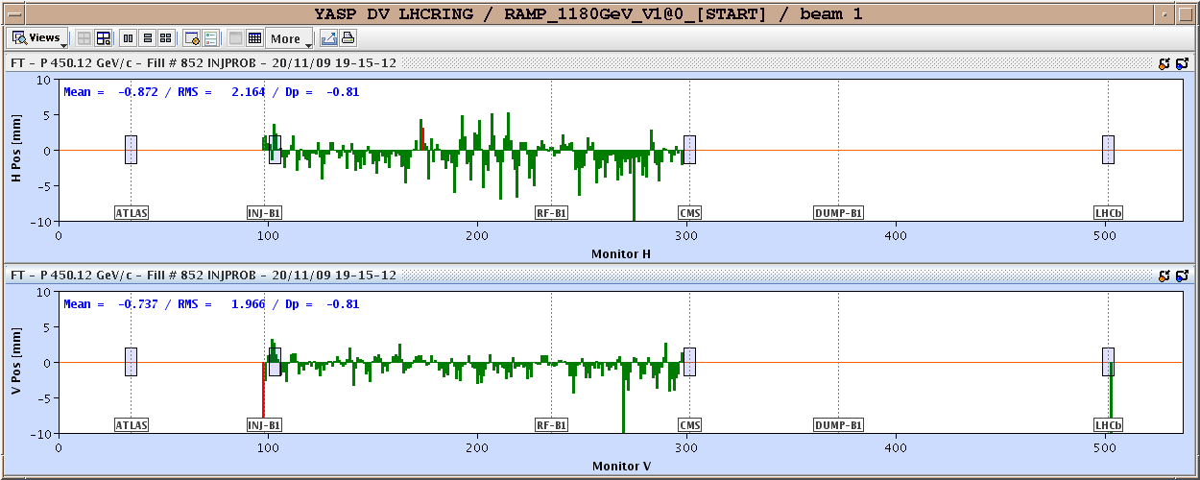
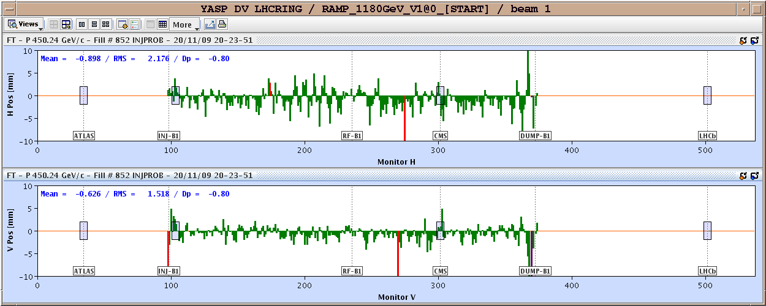
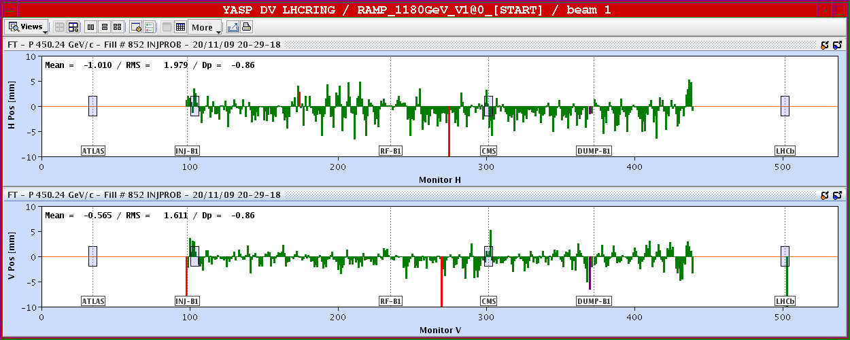
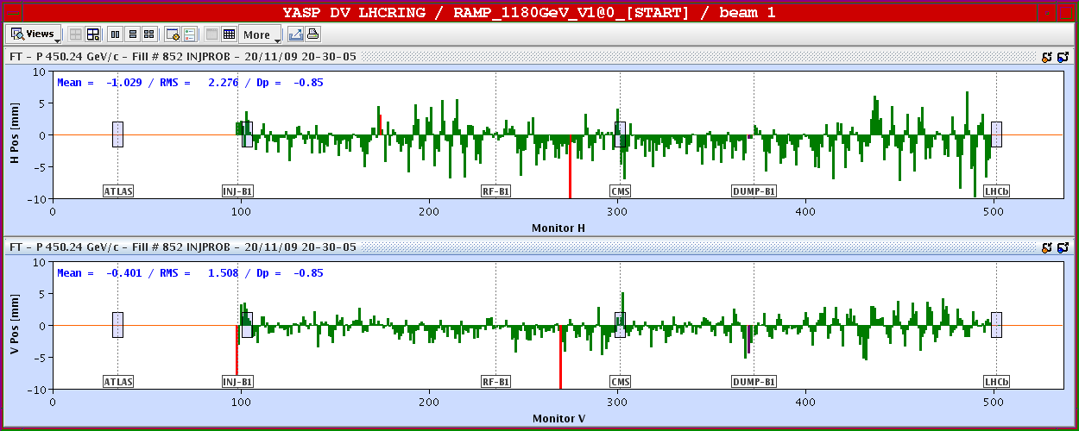
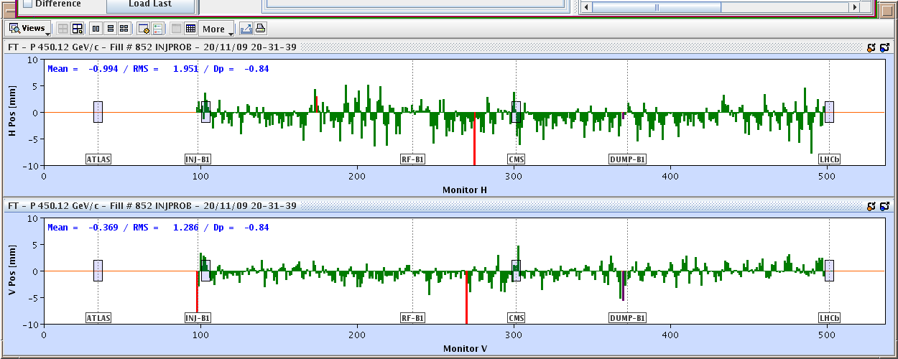
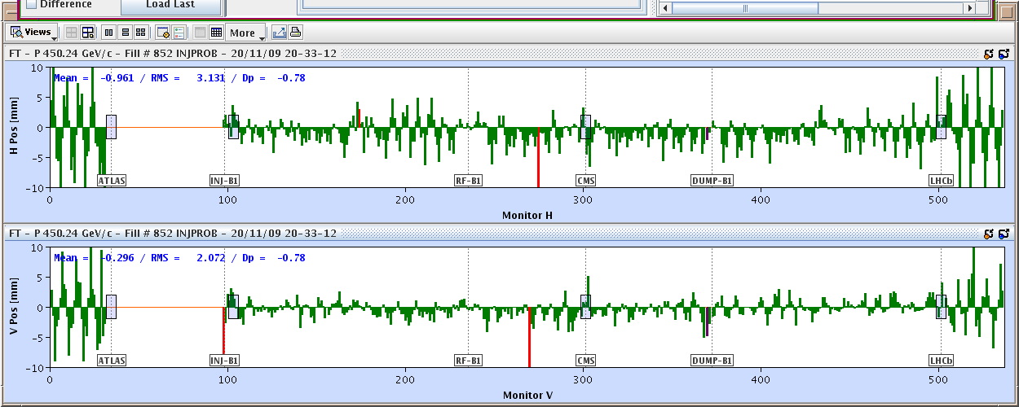
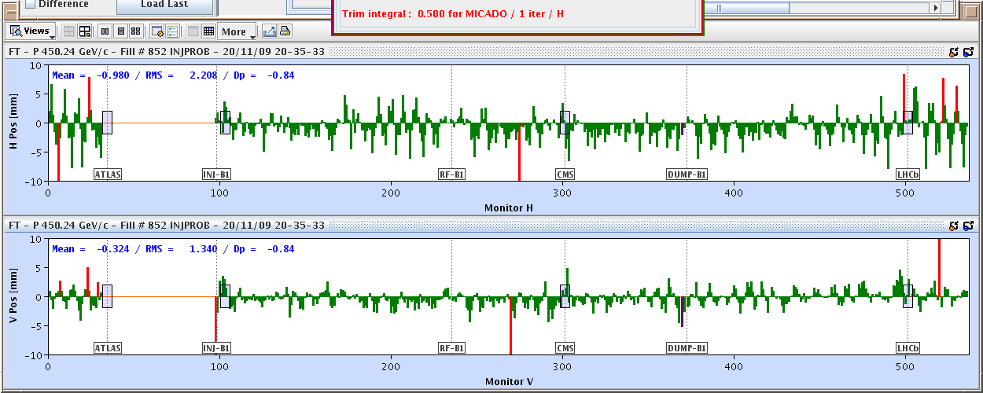
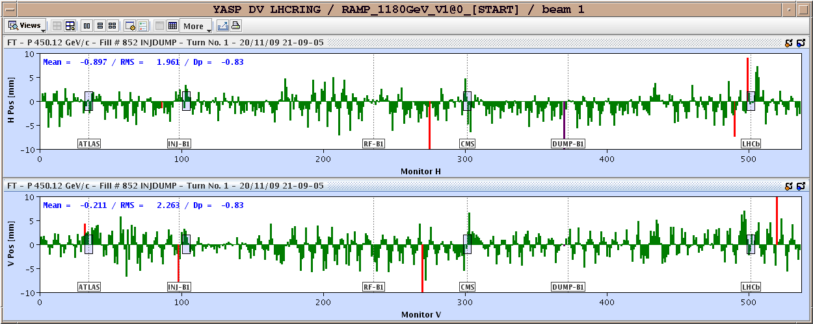
November 20, 2009: Going Around…Again
Total time: 1:43
Then things began to move with dizzying speed…

Slide 26
Progress Since Start-up
Sunday, November 29th, 2009:
Both beams accelerated to 1.18 TeV simultaneously
LHC Highest Energy Accelerator
Monday, December 14th
Stable 2x2 at 1.18 TeV
Collisions in all four experiments
LHC Highest Energy Collider
Tuesday, March 30th, 2010
Collisions at 3.5+3.5 TeV
LHC Reaches target energy for 2010/2011
Then the hard part started…

Slide 27
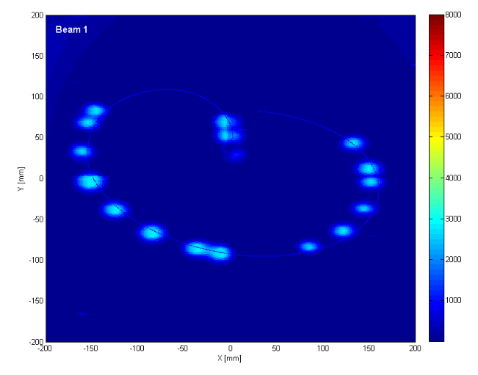
General Plan
Push bunch intensity
Already reached nominal bunch intensity of 1.1x10¹¹ much faster than anticipated.
Increase number of bunches
Go from single bunches to “bunch trains”, with gradually reduced spacing.
At all points, must carefully verify
Beam collimation
Beam protection
Beam abort
Remember:
TeV=1 week for cold repair
LHC=3 months for cold repair
Example: beam sweeping over abort

Slide 28
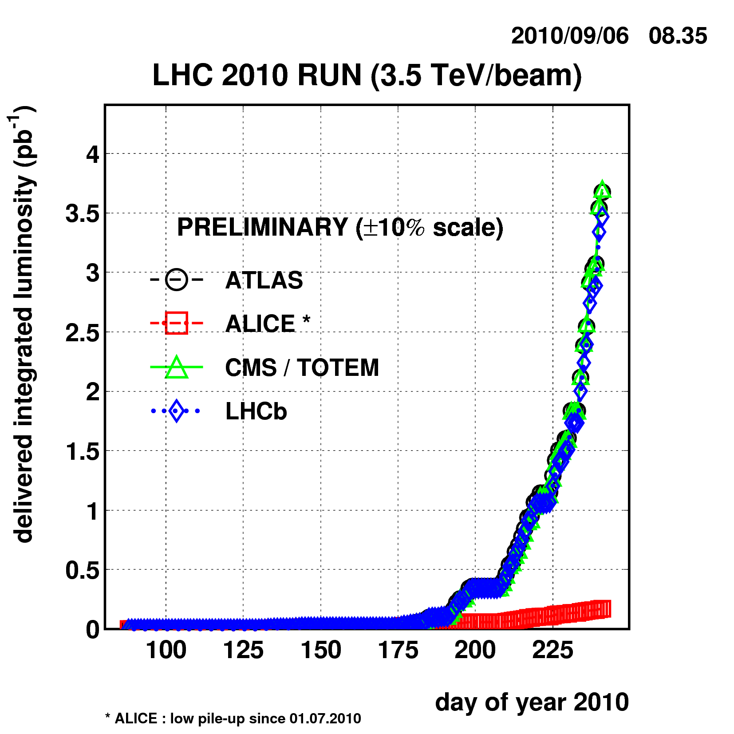
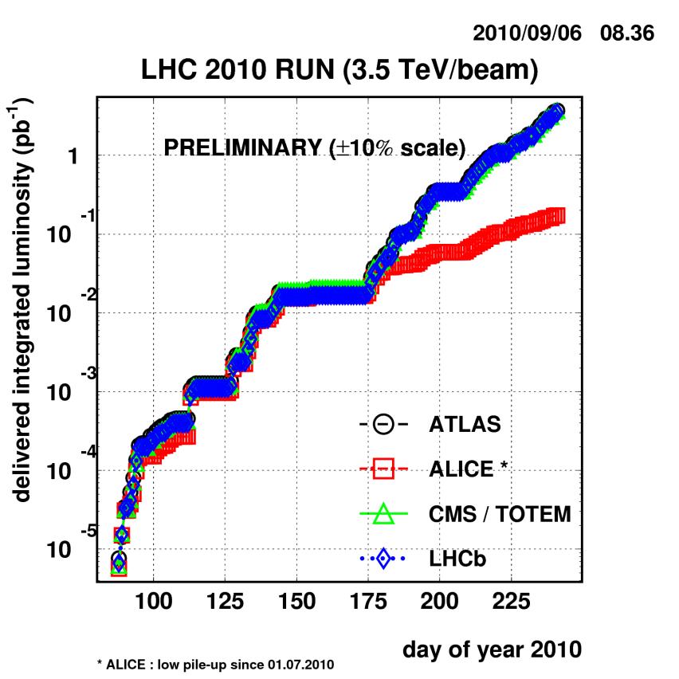
Current Status
Reached full bunch intensity
1.1x10¹¹/bunch
Can’t overstate how important this milestone is.
Peak luminosity: ~1x10³¹ cm⁻²s⁻¹

Slide 29
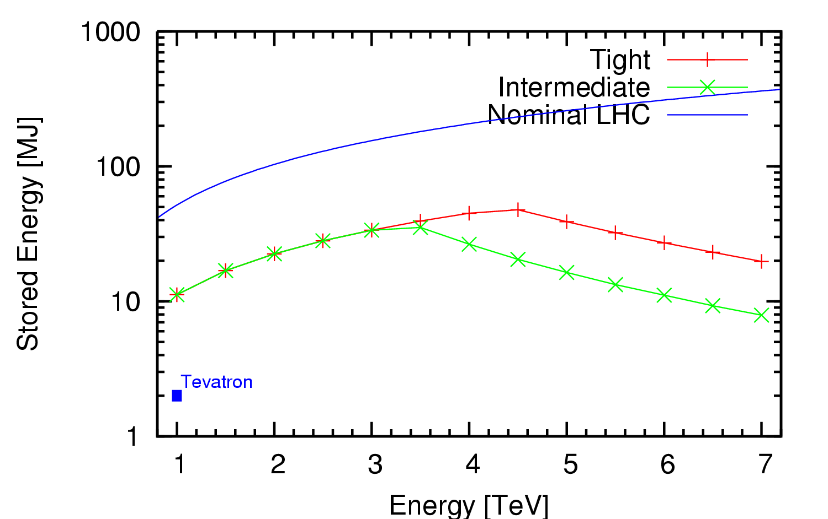
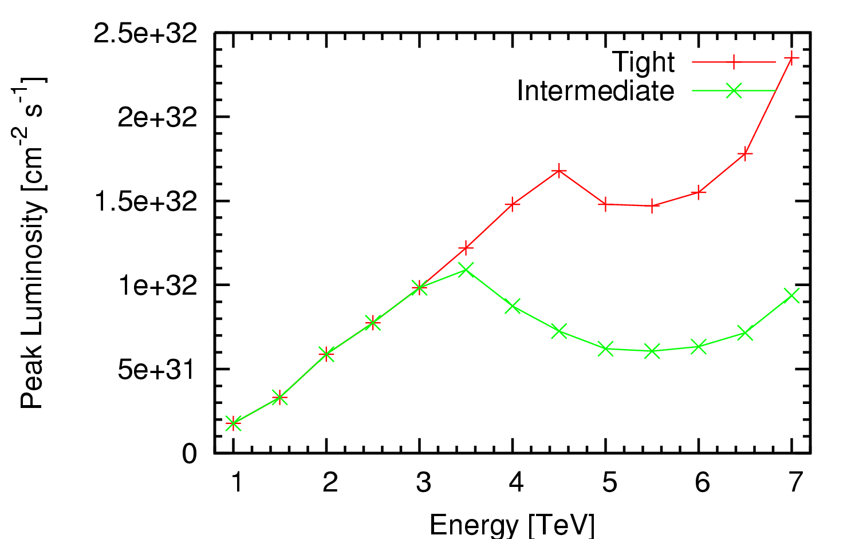
Limits of Present Collimation System*
Existing collimation system cannot reach nominal luminosity
*Ralph Assmann, “Cassandra Talk”

Slide 30
Nominal plan for 2010/2011
1-2% of nominal luminosity
~100 pb⁻¹/month
already exceeded this

Slide 31
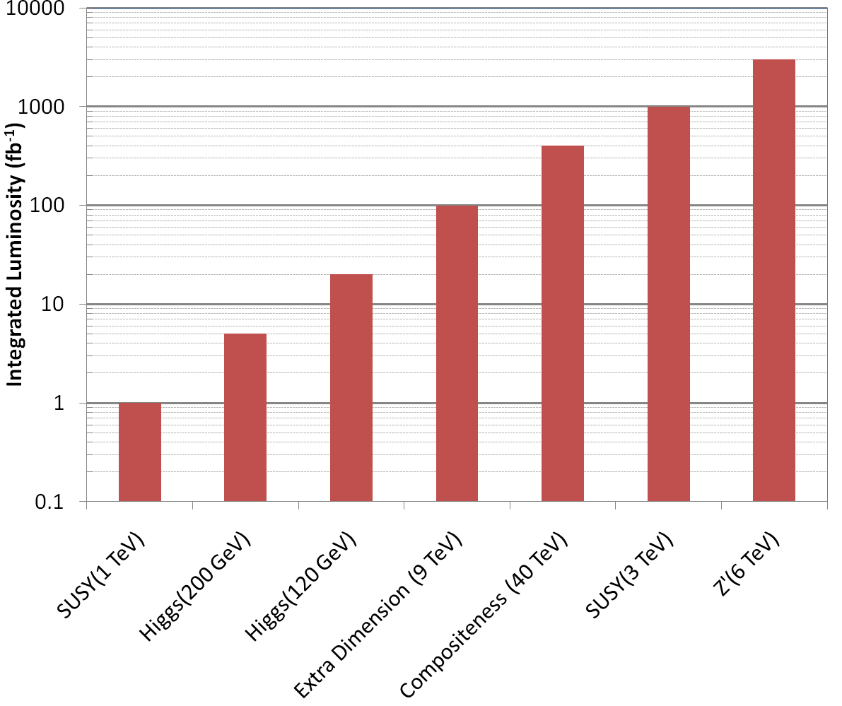
Nice work, but…
3000 fb⁻¹
~ 50 years at nominal luminosity!
The future begins now

Slide 32
Original 2 Phase LHC Upgrade Path
Initial operation (starting in 2008!)
Ramp up to 1x10³⁴ cm⁻²s⁻¹
Phase I upgrade
After ~500 fb⁻¹ (2014?), the inner triplet would be burned up.
Replace with new, large aperture quads, but still NbTi
Replace Linac to increase brightness
Luminosity goal: 2-3x10³⁴ cm⁻²s⁻¹
Phase II upgrade
~2020
Luminosity goal: 1x10³⁵
Details not certain:
New technology for larger aperture quads (Nb₃Sn)
crab cavities to compensate for crossing angle
Improved injector chain (PS2 + SPL)?
No major changes to optics or IR’s
Significant changes

Slide 33
Problems with the Original Plan
By 2014, the LHC will have optimistically accumulated ~10’s of fb⁻¹, and the luminosity will still be increasing.
The lifetime of the existing triplet magnets is ~500 fb⁻¹
Is it likely the experiments will want to stop for a year upgrade followed by a year of re-commissioning?
⇒Pursuing the two phase upgrade only makes sense of the overall timescale is increased dramatically.
Decision
Eliminate the two phase approach, and focus on a single upgrade.
Goal: leveled luminosity of >5x10³⁴ cm⁻²s⁻¹.
Referred to as Phase II, S-LHC, HL-LHC
So how do we get to higher luminosity?
High Luminosity LHC

Slide 34
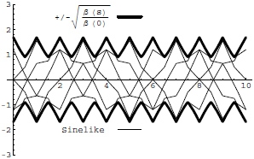
Digression: All the Beam Physics U Need 2 Know
Transverse beam size is given by
Betatron function: envelope determined by optics of machine
Trajectories over multiple turns
Note: emittance shrinks with increasing beam energy ⇒”normalized emittance”
Emittance: area of the ensemble of particle in phase space
Area = ε
Usual relativistic β & γ

Slide 35
Collider Luminosity
For identical, Gaussian colliding beams, luminosity is given by
Revolution frequency
Number of bunches
Bunch size
Betatron function at collision point
Transverse beam size
Normalized beam emittance
Geometric factor, related to crossing angle.

Slide 36
Limits to LHC Luminosity*
Rearranging terms a bit…
Total beam current. Limited by:
Uncontrolled beam loss!
E-cloud and other instabilities
Brightness, limited by
Injector chain
Max. beam-beam
If n_{b}>156, must turn on crossing angle…
β at IP, limited by
magnet technology
chromatic effects
…which reduces this
*see, eg, F. Zimmermann, “CERN Upgrade Plans”, EPS-HEP 09, Krakow

Slide 37
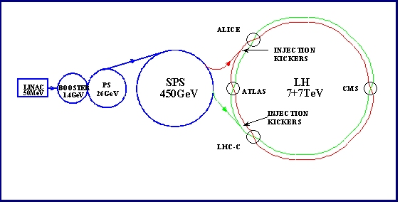
Current LHC Injector Chain
Particularly important
Electron cloud and other instabilities
Space Charge Limitations at Booster and PS injection
Transition crossing in PS and SPS
Schematic ONLY. Scale and orientation not correct

Slide 38
Attacking Luminosity on Many Fronts
Total beam current:
Probably limited by electron cloud in SPS
Beam pipe coating?
Feedback system?
Beam size at interaction region
Limited by magnet technology in final focusing quads
Nb₃Sn?
Chromatic effects⇔collimation
Still being investigated
Beam brightness (N_{b}/ε)
Limited by injector chain
New LINAC
Increased Booster Energy
PS⇒PS2
Biggest uncertainty is how to deal with crossing angle…
unlikely

Slide 39
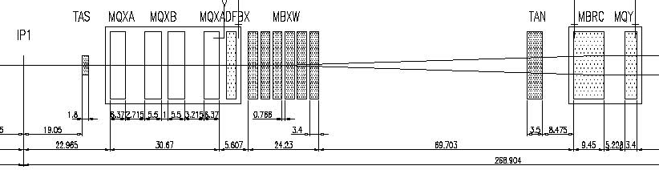
IR Layout and Crossing Angle
Present Separation Dipole
Final Triplet
IP
~59 m
Nominal Bunch spacing: 25 ns ⇒7.5 m
Collision spacing: 3.75 m
~2x15 parasitic collisions per IR
To eliminate crossing angle would require separation dipole ~3 m from IP, ie within detector!
“Early Separation” scheme
Implement Crossing Angle for n_{b}>156

Slide 40
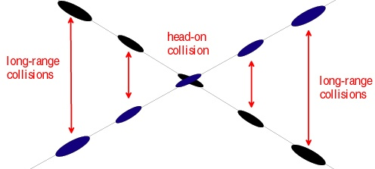
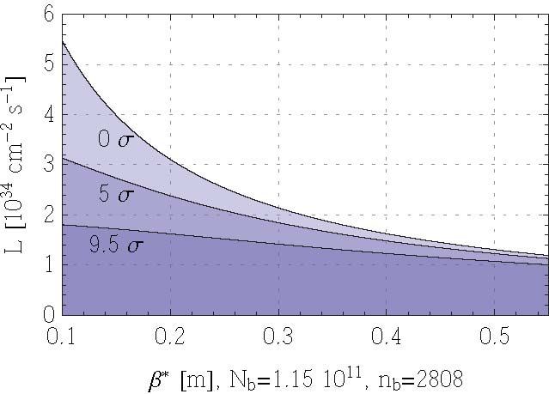
Effect of Crossing Angle
Reduces luminosity
“Piwinski Angle”
Separation of first parasitic interaction
No crossing angle
Effect increases for smaller beam
Nominal crossing angle (9.5σ)
Conclusion: without some sort of compensation, crossing angle effects will ~cancel any benefit of improved focus optics!
Limit of current optics
Upgrade plan

Slide 41
Crossing Angle: Not All Bad
Crossing angle reduces luminosity, but also reduces beam-beam effects
In principle, effects should cancel and we can increase the bunch size; however, because of limits on total beam current, go to big, flat, bunches at 50 ns
⇒ lots of event pile-up
same R factor
“Large Piwinksi Angle” (LPA) Solution

Slide 42
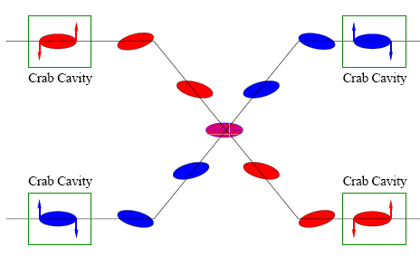
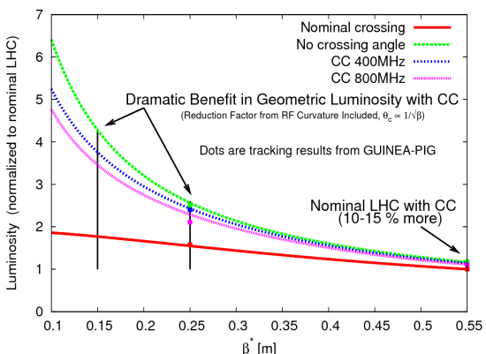
Other Option: Crab Cavities
Lateral deflecting cavities allow bunches to hit head on even though beams cross
Successfully used a KEK
Additional advantage:
The crab angle is an easy knob to level the luminosity, stretching out the store and preventing excessive pile up at the beginning.

Slide 43
Summary of Options (Not Quite Up to date)
Requires magnets close to detectors
Requires (at least) PS2
Big pile-up
Parameter | Symbol | Initial | Full Luminosity Upgrade
 |  |  | Early Sep. | Full Crab | Low Emit. | Large Piw. Ang.
transverse emittance | ε [μm] | 3.75 | 3.75 | 3.75 | 1.0 | 3.75
protons per bunch | N_{b} [10¹¹] | 1.15 | 1.7 | 1.7 | 1.7 | 4.9
bunch spacing | Δt [ns] | 25 | 25 | 25 | 25 | 50
beam current | I [A] | 0.58 | 0.86 | 0.86 | 0.86 | 1.22
longitudinal profile |  | Gauss | Gauss | Gauss | Gauss | Flat
rms bunch length | σ_{z} [cm] | 7.55 | 7.55 | 7.55 | 7.55 | 11.8
beta* at IP1&5 | β∗ [m] | 0.55 | 0.08 | 0.08 | 0.1 | 0.25
full crossing angle | θ_{c} [μrad] | 285 | 0 | 0 | 311 | 381
Piwinski parameter | φ=θ_{c}σ_{z}/(2*σ_{x}*) | 0.64 | 0 | 0 | 3.2 | 2.0
peak luminosity | L [10³⁴ cm⁻²s⁻¹] | 1 | 14.0 | 14.0 | 16.3 | 11.9
peak events/crossing |  | 19 | 266 | 266 | 310 | 452
initial lumi lifetime | τ_{L} [h] | 22 | 2.2 | 2.2 | 2.0 | 4.0
Luminous region | σ_{l} [cm] | 4.5 | 5.3 | 5.3 | 1.6 | 4.2
excerpted from F. Zimmermann, “LHC Upgrades”, EPS-HEP 09, Krakow, July 2009

Slide 44
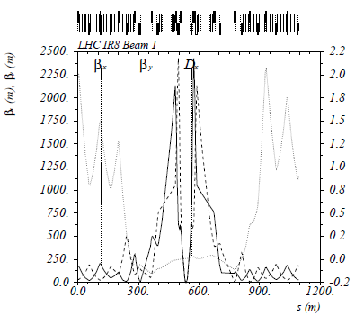
The Case for New Quadupoles
HL-LHC Proposal: β*=55 cm ⇒ β*=10 cm
Just like classical optics
Small, intense focus ⇒ big, powerful lens
Small β*⇒huge β at focusing quad
Need bigger quads to go to smaller β*
Existing quads
70 mm aperture
200 T/m gradient
Proposed for upgrade
At least 120 mm aperture
200 T/m gradient
Field 70% higher at pole face
⇒ Beyond the limit of NbTi

Slide 45
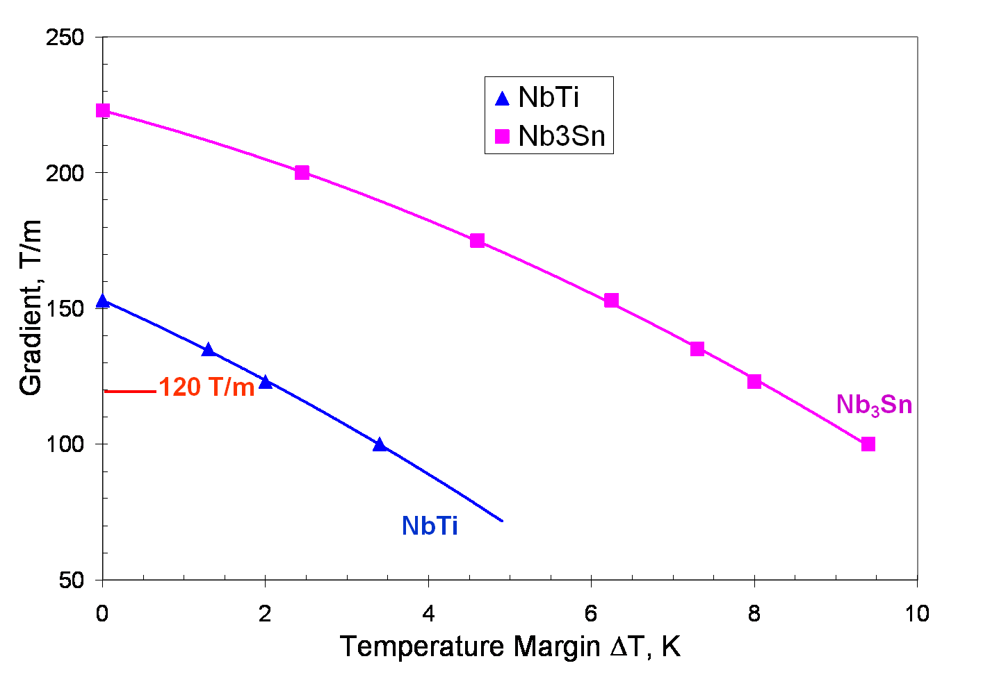
Motivation for Nb₃Sn
Nb₃Sn can be used to increase aperture/gradient and/or increase heat load margin, relative to NbTi
Limit of NbTi magnets
Very attractive, but no one has ever built accelerator quality magnets out of Nb₃Sn
Whereas NbTi remains pliable in its superconducting state, Nb3Sn must be reacted at high temperature, causing it to become brittle
Must wind coil on a mandril
React
Carefully transfer to yolk
120 mm aperture

Slide 46
Plan for Next Decade
Run until end of 2011, or until 1 fb⁻¹ of integrated luminosity
About .5% of the way there, so far
Shut down for ~15 month to fully repair all ~10000 faulty joints
Resolder
Install clamps
Install pressure relief on all cryostats
Shut down in 2016
Tie in new LINAC
Increase Booster energy 1.4->2.0 GeV
Finalize collimation system (LHC collimation is a talk in itself)
Shut down in 2020
Full luminosity: >5x10³⁴ leveled
New inner triplets based on Nb₃Sn
Crab cavities
Large Pewinski Angle being pursued as backup

Slide 47
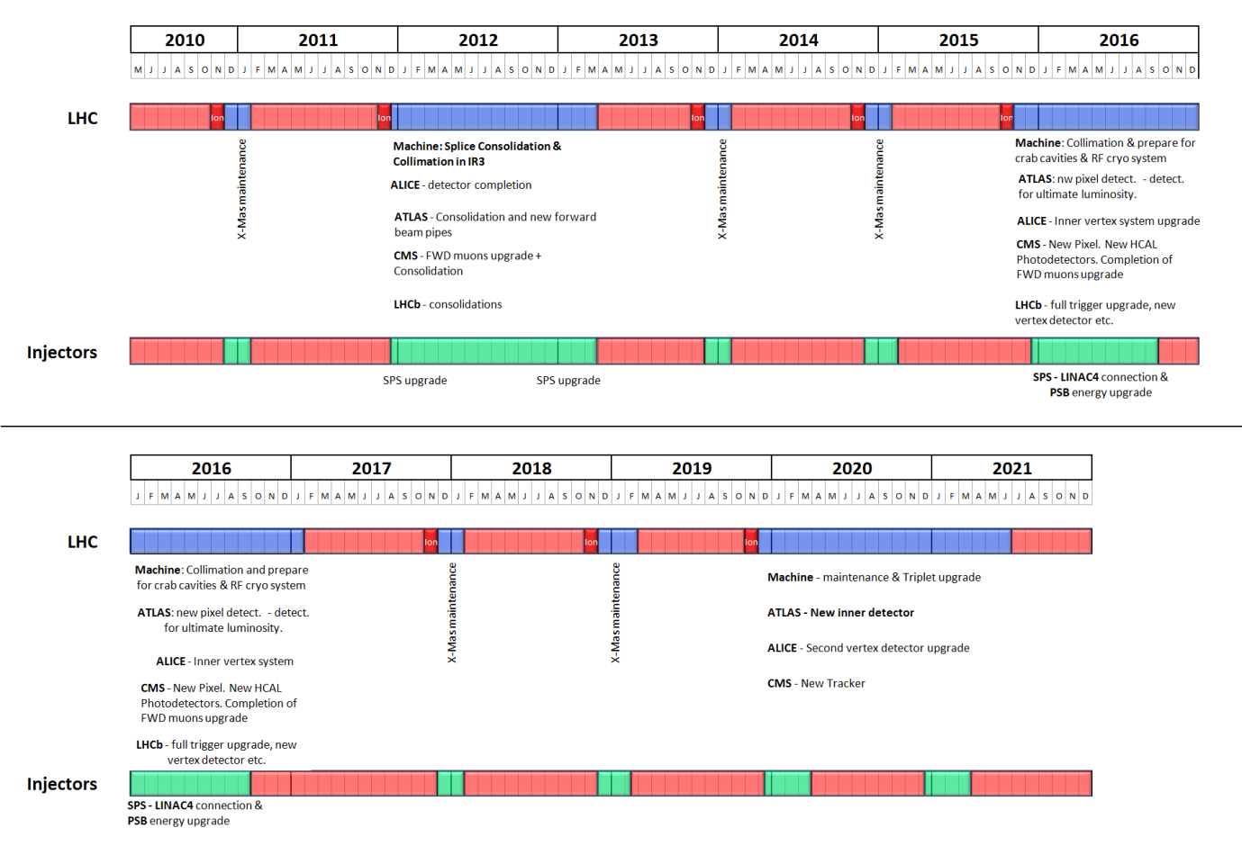
Tentative LHC Timeline
Energy: 3.5 TeV
Energy: 6-7 TeV
Collimation limit ~2x10³²
Collimation limit .5-1x10³⁴
Energy: ~7.0 TeV
Energy: ~7 TeV
Luminosity→1x10³⁴
Lum.→>5x10³⁴
Collimation limit >5x10³⁴

Slide 48
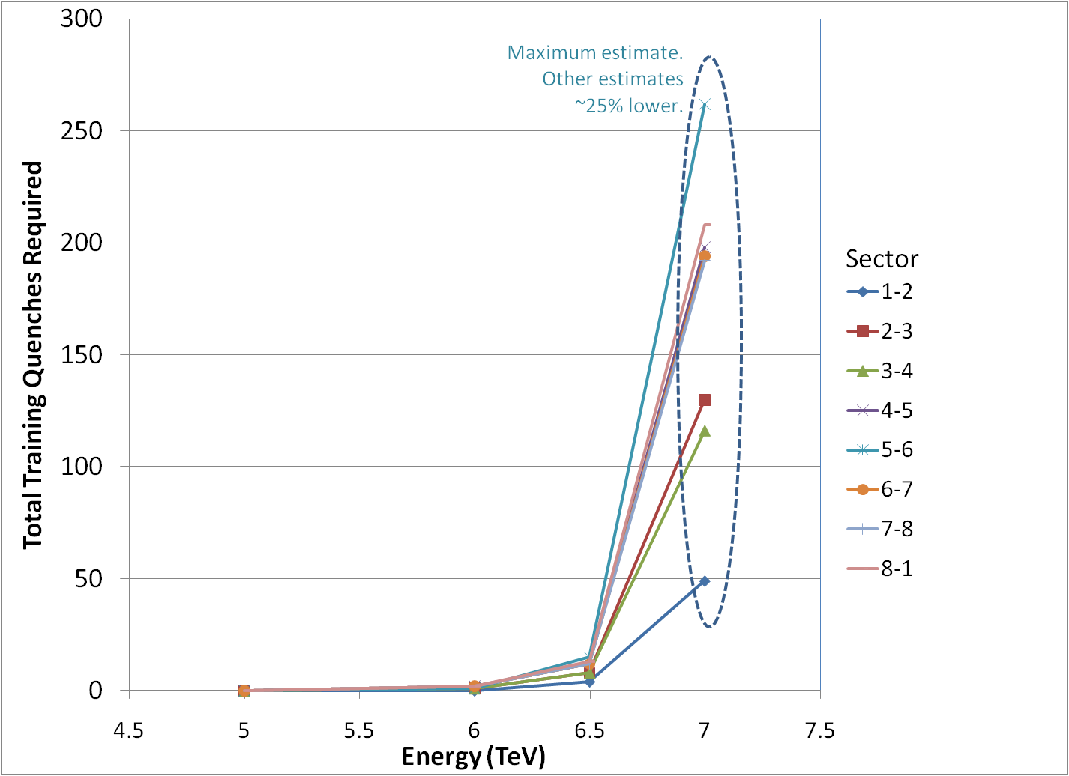
Getting to 7 TeV*
Note, at high field, max 2-3 quenches/day/sector
Sectors can be done in parallel/day/sector (can be done in parallel)
No decision yet, but it will be a while
*my summary of data from A. Verveij, talk at Chamonix, Jan. 2009

Slide 49
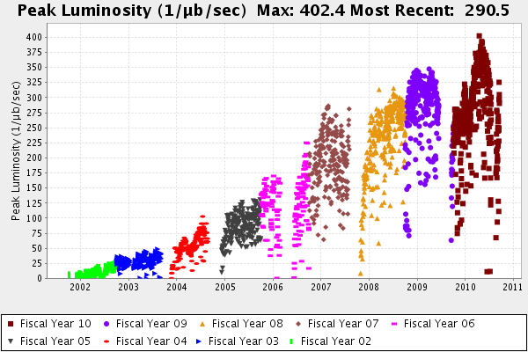
Comparison: Tevatron Run II
LHC Nominal
(10,000)
Ultimate Run II Goal
2011 Goal
Initial Run II Goal
Run I record
LHC Now

Slide 50
Enough about science…Let’s talk management!
Upgrade planning will be organized through EuCARD*,
Centrally managed from CERN (Lucio Rossi)
Non-CERN funds provided by EU
Non-EU partners (KEK, LARP, etc) will be coordinated by EuCARD, but receive no money.
Work Packages:
WP1: Management
WP2: Beam Physics and Layout
WP3: Magnet Design
WP4: Crab Cavity Design
WP5: Collimation and Beam Losses
WP6: Machine Protection
WP7: Machine/Experiment Interface
WP8: Environment & Safety
Significant LARP and other US Involvement
*European Coordination for Accelerator R&D

Slide 51


Relevance of LARP to CERN Upgrade
Letter to Dennis Kovar, Head Office of DOE Office of High Energy Physics, 17-August-2010
(…)

Slide 52
LHC Accelerator Research Program (LARP)
Proposed in 2003 to coordinate efforts at US labs related to the LHC accelerator (as opposed to CMS or ATLAS)
Originally FNAL, BNL, and LBNL
SLAC joined shortly thereafter
Some work (AC Dipole) supported at UT Austin
LARP Goals
Advance International Cooperation in High Energy Accelerators
Advance High Energy Physics
By helping the LHC integrate luminosity as quickly as possible
Advance U.S. Accelerator Science and Technology
LARP includes projects related to initial operation, but a significant part of the program concerns the LHC upgrades

Slide 53

LARP Contributions to Initial LHC Operation
Schottky detector
Used for non-perturbative tune measurements (+chromaticities, momentum spread and transverse emmitances)
Tune tracking
Implement a PLL with pick-ups and quads to lock LHC tune
Investigating generalization to chromaticity tracking
AC dipole
US AC dipole to drive beam
Measure both linear and non-linear beam optics
Luminosity monitor
High radiation ionization detector integrated with the LHC neutral beam absorber (TAN) at IP 1 and 5.
Low level RF tools
Leverage SLAC expertise for in situ characterization of RF cavities
Personnel Programs…

Slide 54

LARP Personnel Programs
Long Term Visitors program
Pay transportations and living expenses for US scientists working at CERN for extended periods (at least 4 months)
Extremely successful at integrating people into CERN operations
Interested parties coordinate with a CERN sponsor and apply to the program (Uli Wienands, SLAC)
Toohig Fellowship
Named for Tim Toohig.
Open to recent PhD’s in accelerator science OR HEP.
Successful candidates divide their time between CERN and one of the four host labs.
Currently 2 Toohig Fellows in program (+2 offers).

Slide 55


LARP Accelerator R&D for Future LHC
Rotatable collimators
Can rotate different facets into place after catastrophic beam incidents
Delivering prototype for test this year
Crystal Collimation
Beam-beam studies
General simulation
Electron lens (See Shiltsev talk)
Wire compensation
Electron cloud studies
Study effects of electron cloud in LHC and injector chain

Slide 56


Collimator Status
First prototype nearly complete at SLAC
Will be shipped to CERN for impedance and functionality testing in the SPS
Second test will occur next year in the new CERN HiRadMat facility
Test behavior under catastrophic beam event
If they pass these tests, they will be part of the collimation upgrade in 2016.

Slide 57



LARP Crab Cavity Work
WG HOM coupler
Coax LOM/SOM coupler
LARP has been the primary advocate of crab cavities for the LHC upgrade
In fall, 2009 CERN formally endorsed crab cavities for HL-LHC
Contingent on a plan to operate system safely!!
Technical challenges
Designing “compact” cavities that can fit in the available space
Machine protection
“local” vs “global” scheme
Actual production is beyond the scope of LARP
LARP R&D ⇒ separate, international(?) project
Power coupler
SLAC half wave
Fermilab “mushroom”
JLAB “toaster”

Slide 58

LARP Magnet Development Tree
Completed
Achieved
220 T/m
Length scale-up
High field
Accelerator features
Being tested

Slide 59




LQ (4m x 90mm) Assembly and Test
Reaction/Potting
(BNL and FNAL)
Instrumentation and
heater traces (LBNL)
Winding/curing (FNAL)

Slide 60


LQ Test
Tested in vertical test facility at Fermilab

Slide 61


HQ (1m x 120 mm) design
Goal: 200 T/m gradient
Unique “shell” preloading structure

Slide 62



HQ Test
Prototype tested at LBNL
Achieved 157 T/m
Less than goal, but more than NbTi
Electrical fault in voltage tap
Investigating
Will repair and test at CERN

Slide 63
Beyond HQ
The aperture for the focus quadrupoles in the HL-LHC has not yet been determined
Could be as high as 150 mm
In the mean time, LARP will build several “longer” (~2m) 120 mm magnets to investigate
Field quality
Alignment
Thermal behavior
Full length prototype, at final aperture will be part of construction project R&D (~2015).

Slide 64
Marching Toward 2020
The EuCARD HL-LHC collaboration will submit a study proposal in November of this year
Conceptual Design Report: ~2013
Technical Design Report: ~2015
LARP is a ~$12M/year R&D organization
Major activities will need to “spin off” as independent projects
Nb₃Sn quardupole project should be in place by 2014-2015 to be ready for 2020
Crab cavities are a ~$50M international effort that will need to be centrally coordinated from CERN

Slide 65

The Long Road to Discovery
Even with the higher luminosity, still need a lot of time to reach the discovery potential of the LHC
Lots of new challenges between now and then!
Z’@6TeV
ADD X-dim@9TeV
SUSY@3TeV
Note: VERY outdated plot. Ignore horizontal scale.
Could conceivably get to 3000 fb⁻¹ by 2030.
3000
Compositeness@40TeV
H(120GeV)→γγ
300
Higgs@200GeV
SUSY@1TeV
30
200 fb⁻¹/yr
HL-LHC Upgrade
10-20
fb⁻¹/yr
50-100 fb⁻¹/yr
500 fb⁻¹/yr
50 x Tevatron luminosity
250 x Tevatron luminosity

Slide 66
Summary
The LHC is the most complex scientific apparatus ever built – by a good margin.
The start up has been remarkably smooth.
Things look very good, but there’s still a long road ahead.
Even thought the machine is just starting up, we’re already late for the future.

Slide 67
Acknowledgements and Further Reading
This talk represents the work of an almost countless number of people.
I have incorporated significant material from:
The annual Chamonix meetings
http://tinyurl.com/Chamonix2009 (“the incident”)
http://tinyurl.com/Chamonix2010 (upgrade plans)
Frank Zimmermann’s many luminosity talks, eg. EPS-HEP, Krakow 2009
http://tinyurl.com/Zimmermann-Krakow
Talks presented at LARP collaborations and DOE reviews
See http://www.uslarp.org/
Apologies for the many interesting topics I didn’t cover!

Slide 68
Staying Informed
Twitter feed (big news):
http://twitter.com/cern
LHC Coordination Page:
http://lpc.web.cern.ch/lpc/
LARP Activities:
http://www.uslarp.org/

